Slide 1
Treatment

Slide 2
The Big Questions / Issues
Are all good forms of therapy equivalent?
“Dodo bird verdict”
If so, what makes them all work?
Do drugs work, enough to be worth the risks?
No better than therapy for most people
Most people don’t have a “brain” disorder!?

Slide 3
Therapy Definition
Psychotherapy is a unique form of relationship:
Focus entirely on client’s needs and problems
Therapist is paid
Therapy takes place in structured setting
Each meeting is time-limited (e.g., 50min)
The relationship is expected to terminate

Slide 4
Forms of Therapy
Current, Empirically Supported Therapy (EST):
Cognitive-Behavior Therapy (CBT): change thoughts and behaviors (GAD, Panic, Depression)
Mindfulness-based CT (MBCT): + acceptance
Behavior Therapy (BT): conditioning (Depression)
Exposure Therapy (OCD, phobias)
(also Group, Family, Couple Therapy)
Integrative: most common, tailor to client
Old: Psychoanalysis, Psychodynamic Therapy, Client-Centered Therapy, REBT

Slide 5
What have you had?
Which form of therapy have you experienced?
Cognitive-Behavior Therapy (CBT)
Behavior Therapy (including exposure)
Integrative / eclectic
Psychoanalysis / psychodynamic / other
None

Slide 6
Science Works!
Behavioral Therapy = Behaviorism Theory
Cognitive Therapy = Cognitive Theory
Mindfulness = ?? Theory ☺

Slide 7
Cognitive (Behavior) Therapy
Goal: change negative beliefs, automatic thoughts (negative cognitive triad, Beck) *and behaviors*
Method: get client to question beliefs, confront negative thoughts with positive facts..
Challenges: Many ways of focusing on negative: Overgeneralization; Discounting positives; Catastrophizing; Mind-reading; Magnifying; Filtering

Slide 8
Behaviorism and Exposure
Behavior Therapy: Use operant, classical conditioning to shape positive patterns of behavior (prizes, token economy, contingency mgmt)
Exposure Therapy: Extinguish negative associations through careful extinction training: systematic desensitization (don’t activate “US”)
.. or flooding (wear it down!)

Slide 9
Important Distinctions
Critical to distinguish classes of disorders:
Anxiety and Depression (by far most common)
Probably not “biological” for most people
Drugs may help, but not because they are fixing a broken biological mechanism – just make u feel better (in which case, why not just take MDMA?)
Schizophrenia and Bipolar are more biological
Not very well treated by drugs, but could be!?
Scz is common failure mode of many diff causes: hard to fix with one intervention.

Slide 10
Therapy Works!
Average client is better than 80% of non-clients!
Randomized Controlled Trials: gold standard (random assignment -> causal not just correlation)
Clinical Significance: need more than a statistical effect – need an actual “cure” (e.g., couple therapy example: does couple stay together??) – Not widely achieved!!

Slide 11
Why All Therapies Work (everyone’s a winner! = dodo bird)
Theraputic alliance; Therapist allegiance and competence. (Huh?)
Why do these factors make people feel better?
Hope, confidence, positive emotions, willingness to commit effort..
In other words, therapy imparts self-efficacy and reboots goal-driven cognitive system!
CCC = Control

Slide 12
Common Features of Disorders (Common Failure Modes)
Overactive negative affective states (fear, depression) – these are strongest to start with!
Vicious cycle pattern: spiraling downward..
Lose self-esteem, self-concept, positive goals – these are what buffer us from the negative
Plasticity reinforces existing activity: OCD repetition
Scz: “normal” adaptive response to threats:
Brain starts acting weird, so exert extra levels of control – delusions of grandeur in response to ego threat = further separation from reality..

Slide 13
Bottom line
It takes serious work to overcome strength of negative emotional systems:
Easy to be overcome with defeatist, negative thoughts, worries, anxieties, etc
Sometimes you need some help! Someone who can talk you through it, get you pointed in a new direction, etc..
First step is always recognition and acceptance, and understanding that this is just how your brain works, and you just need to work at it to overcome..

Slide 14
Pharmacotherapy
No more effective than “placebo” for most people
Massive conspiracy marketing from drug companies, pushing a “miracle cure” for shiny happy people!
Major side effects and risks, including extreme violence, suicide in some cases..

Slide 15
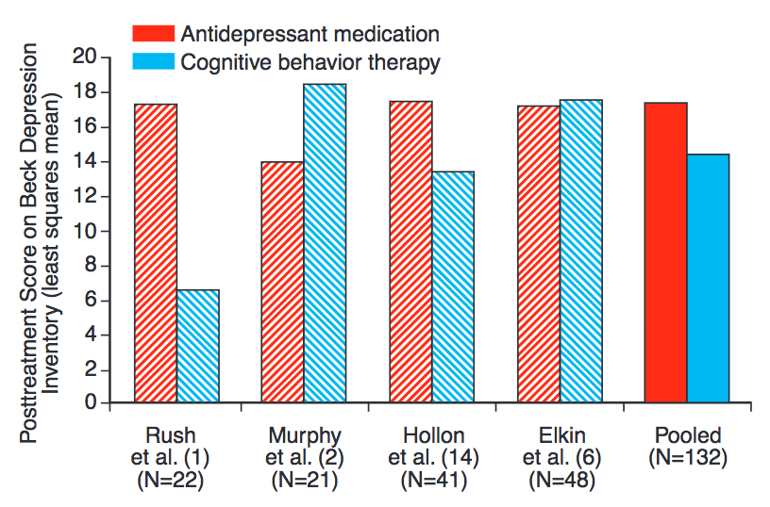

Slide 16
Serotonin is VERY Complex
Many different 5HT pathways, receptors, each with different, opposing effects
“Happy” 5HT pathway: interfascicular raphe (DRI)
“Sad” 5HT pathway: caudal raphe?
Many others..!
Chemical imbalance vs. chemical intervention / jumpstart?

Slide 17
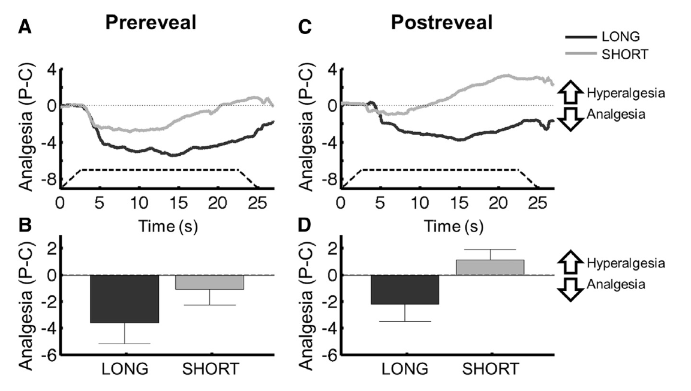
Placebo Data
Telling people about placebo (“postreveal”) doesn’t overcome prior long conditioning, but does for short amount of prior conditioning!

Slide 18
Hey, what about ADHD??
Neurodevelopmental: in a different category from other disorders
Volkow et al (2011): “These findings provide evidence that disruption of the dopamine reward pathway is associated with motivation deficits in ADHD adults, which may contribute to attention deficits and supports the use of therapeutic interventions to enhance motivation in ADHD.”

Slide 19
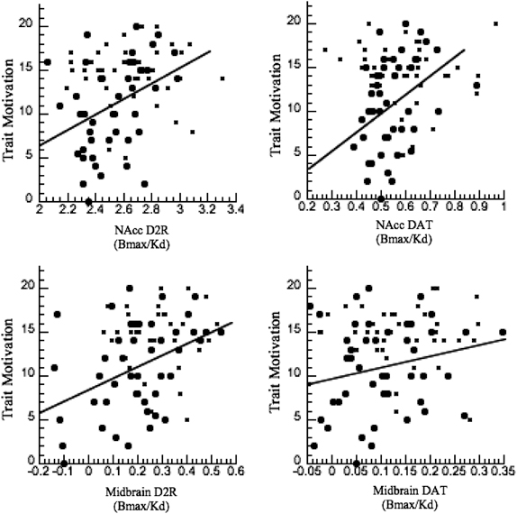
Volkow et al, 2011
Relationship between ventral striatum (basal ganglia) dopamine factors and motivation levels for individual subjects.
D2R = dopamine D2 receptor
DAT = dopamine transporter (re-uptake)

Slide 20
ADHD
Do you have ADHD?
A. Yes, diagnosed, on meds
B. Yes, diagnosed, not on meds
C. Yes, not diagnosed, on meds
D. Yes, not diagnosed, not on meds
E. No.

Slide 21
ADHD
If you answered Yes to ADHD, what is your handedness?
A. Right handed
B. Left handed
C. Bimanual
D. Still don’t have ADHD!

